Slide 1
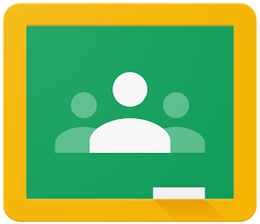
Google Classroom for Students

Slide 2
Content
Login to Google Classroom
Read messages on the “Stream”
View assignments in “Classwork”
Work on an assignment
Add a comment to any assignment
Turn in finished assignment
Unsubmit an assignment
View your grade
Overview of assignments and grades

Slide 3
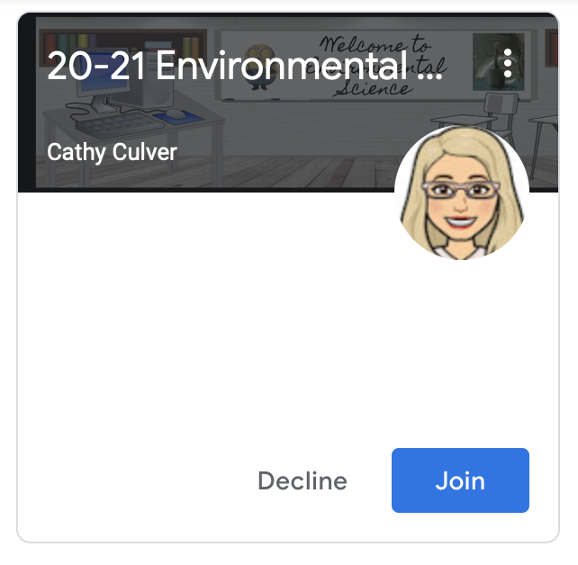
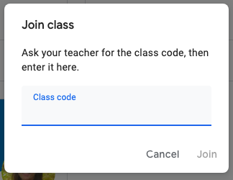
Login to Google Classroom
3️⃣
Go to classroom.google.com and login with your email address and password.
If your teacher invited you to their class by email, you can join the class in the Classroom homepage.
If your teacher asks you to join using a class code, click the “+” at the top right corner.
Enter a class by clicking on the title.
1️⃣
1
2️⃣
2️⃣

Slide 4
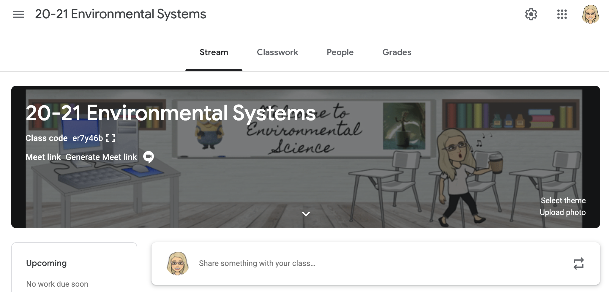
2. Read messages on the stream
The “Stream” is the classes homepage.
Read messages from your teacher.
Posting from students has been disabled.
1️⃣

Slide 5
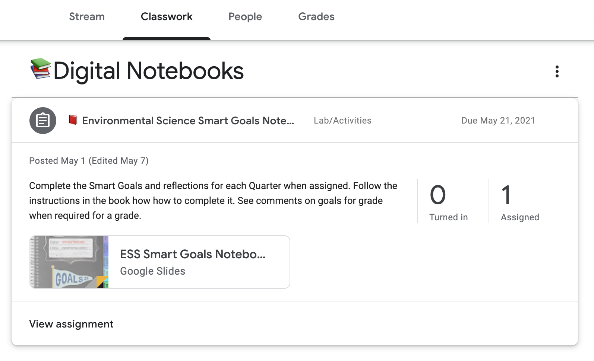
3. View assignments in “Classwork”
Go to “Classwork” to view the work your teacher has assigned to you.
Click on the title
Click on “View Assignment” to work on the assignment.
1️⃣
2️⃣

Slide 6
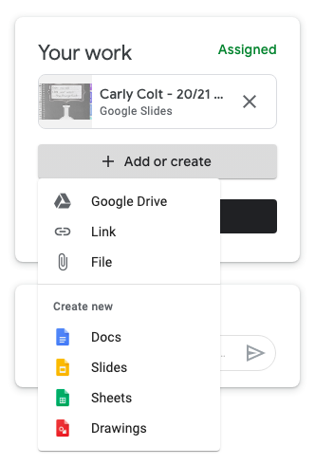
4. Work on an assignment
1️⃣
If your teacher selected “Make a copy for each student” you will find your own copy of the file here. You can open and edit the file.
You can also add or create a file yourself to add to the assignment.
See the next slide for marking an assignment as “Done”
2️⃣

Slide 7
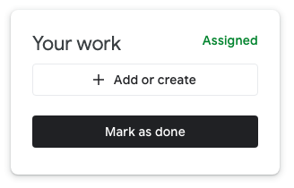
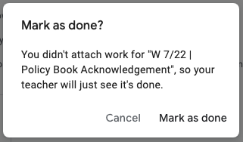
4. Work on an assignment (con’t.)
You can also mark the assignment as “Done” which will tell the teacher you’ve completed the assignment. For example, if you had a worksheet to complete that is a paper copy. The teacher will not see any work unless you attached work to the assignment. This is more for your record keeping than anything. The assignment will no longer be assigned to you and show up in your list of things to complete.
3️⃣

Slide 8
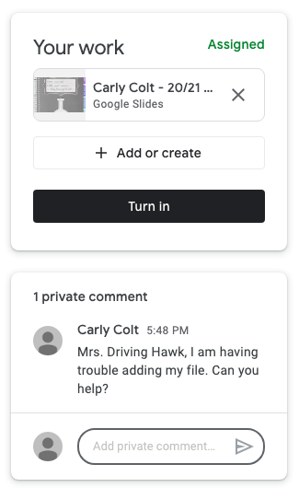
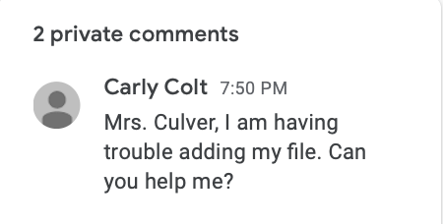
5. Add a comment to an assignment
“Private comments” are only visible to the teacher. This is a great option for when you have a quick question about an assignment and cannot email the teacher. As long as the comment is made at a reasonable hour, the teacher will usually respond quickly.
1️⃣

Slide 9
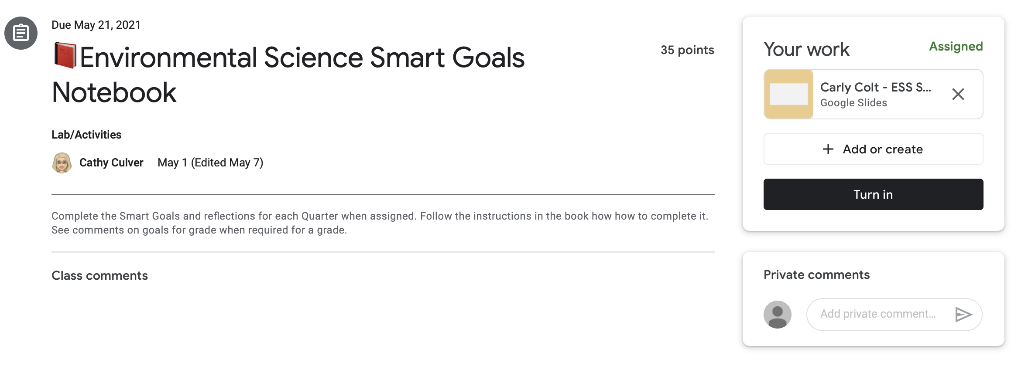
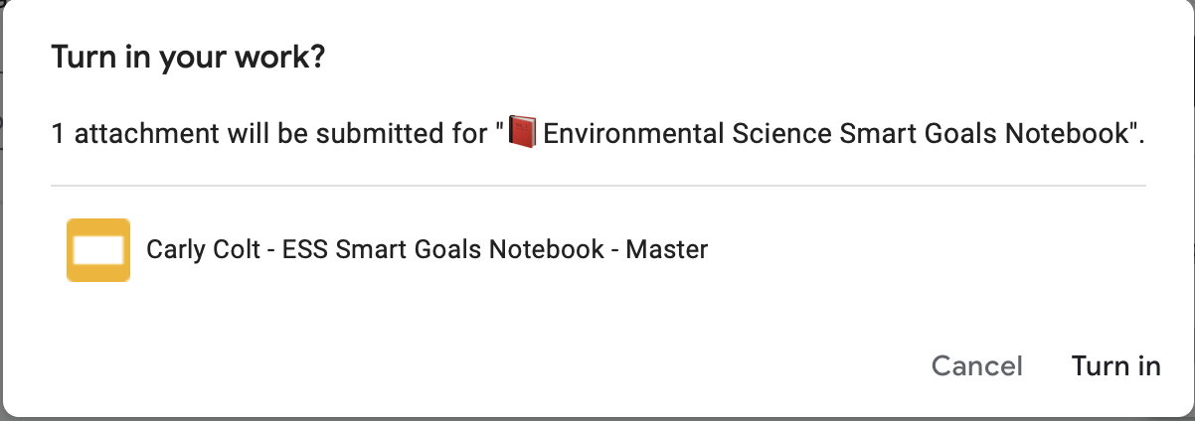
6. Turn in an assignment
Click “Turn In” to submit a finished assignment.
Confirm turning in your assignment by clicking “Turn In” on the confirmation window.
1️⃣
2️⃣

Slide 10
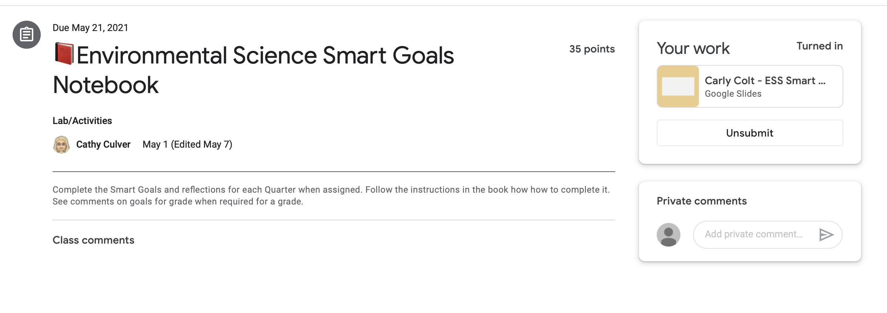
7. Unsubmit an assignment
If you’re not sure about an assignment you submitted, and you want to improve it, you can take back your work before your teacher assess it.
Click “Unsubmit” to take back your work.
Don’t forget to “Turn In” the assignment after improving your work.
1️⃣

Slide 11
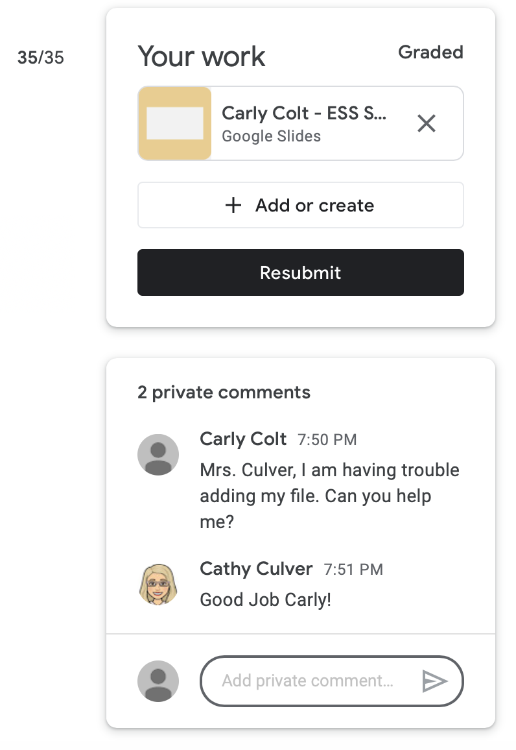
8. View your grade
1️⃣
2️⃣
When a teacher assesses your work, he or she will return it to you.
“Graded” means your assignment has been assessed by your teacher.
This is your grade.
Read the private comment your teacher wrote for you.
If your teacher asks you to improve the assignment, click “Resubmit” after working on your assignment.
3️⃣

Slide 12
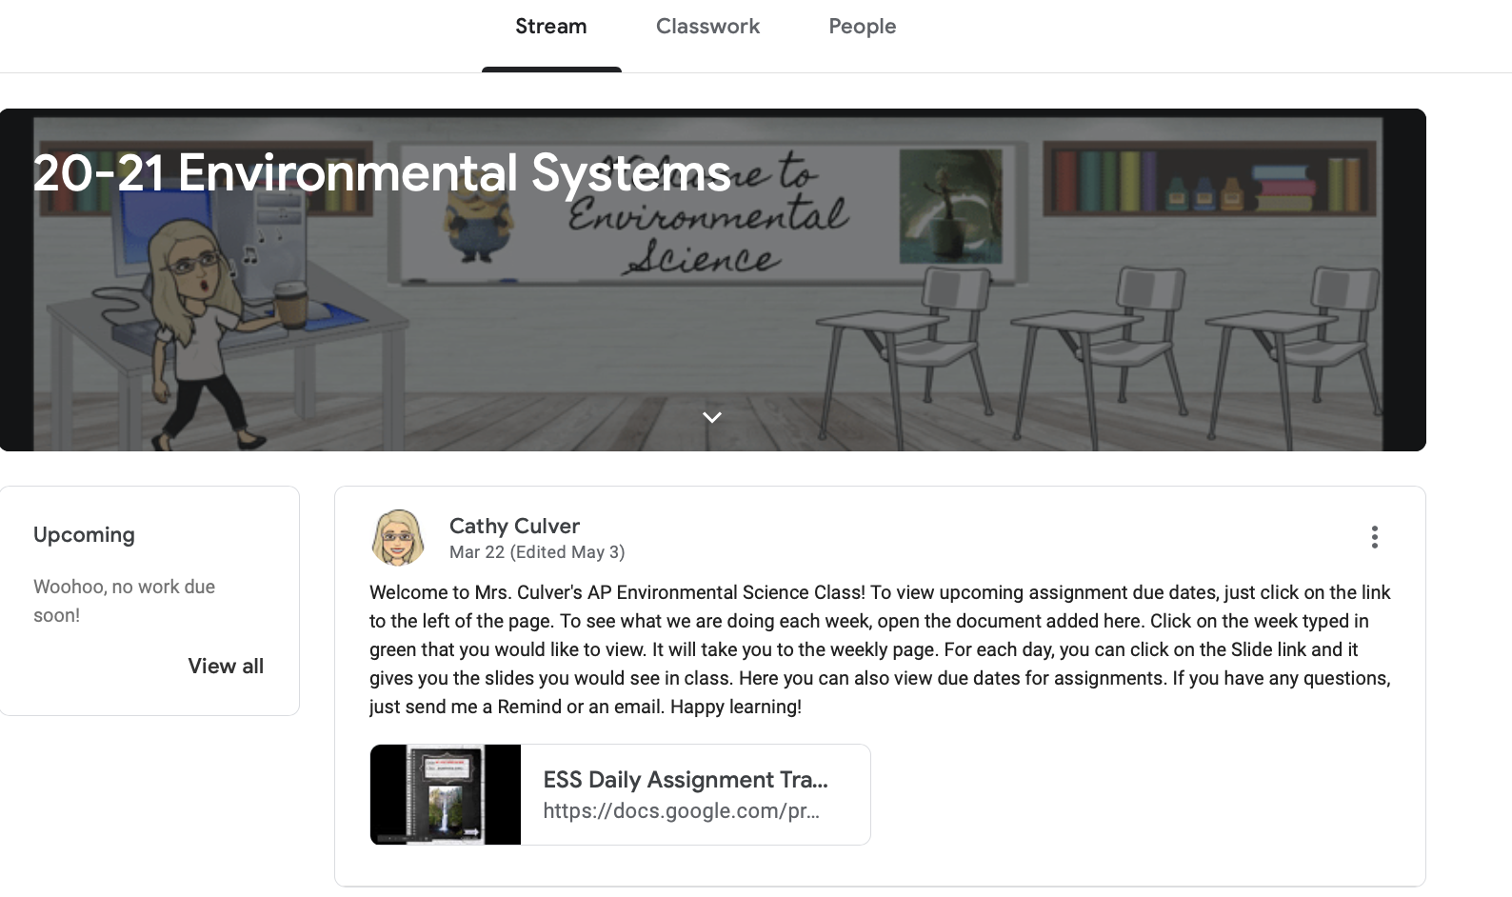
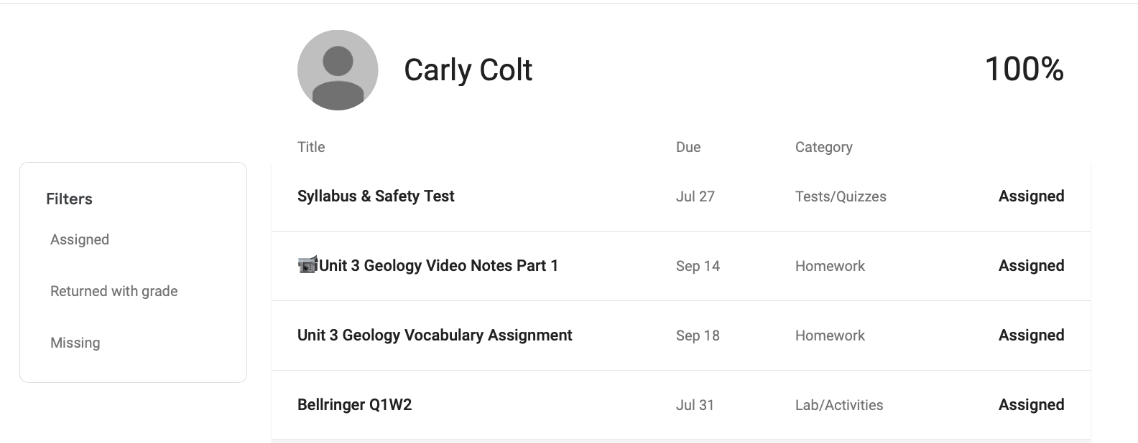
9. Overview of assignments & graded work
You can see an overview of your assigned and graded work.
Go to “Stream” and click “View All”
1️⃣
1️⃣

